Slide 1
An Introduction to Apache Spark

Slide 2
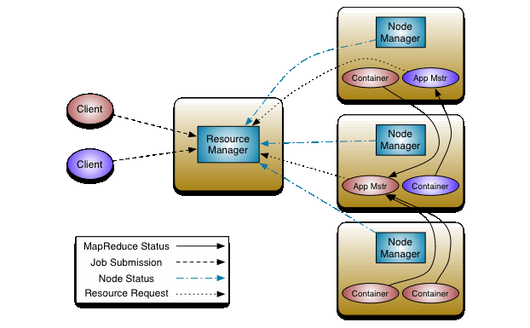
Spark Architecture

Slide 3
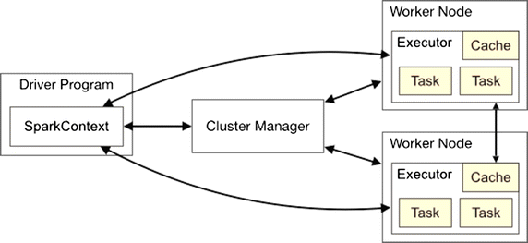
Spark Architecture

Slide 4
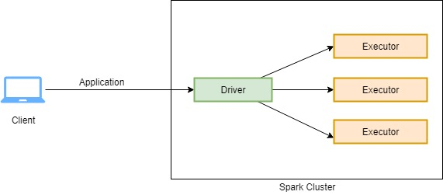
Apache Spark Execution
For every application submitted on spark cluster, spark creates a dedicated Driver process and bunch of Executor processes.
Driver process is responsible for analyzing, distributing, scheduling and monitoring of executor processes.
Whereas the executor process is only responsible for running the task they were assigned by drivers and reporting the status back to the driver.

Slide 5
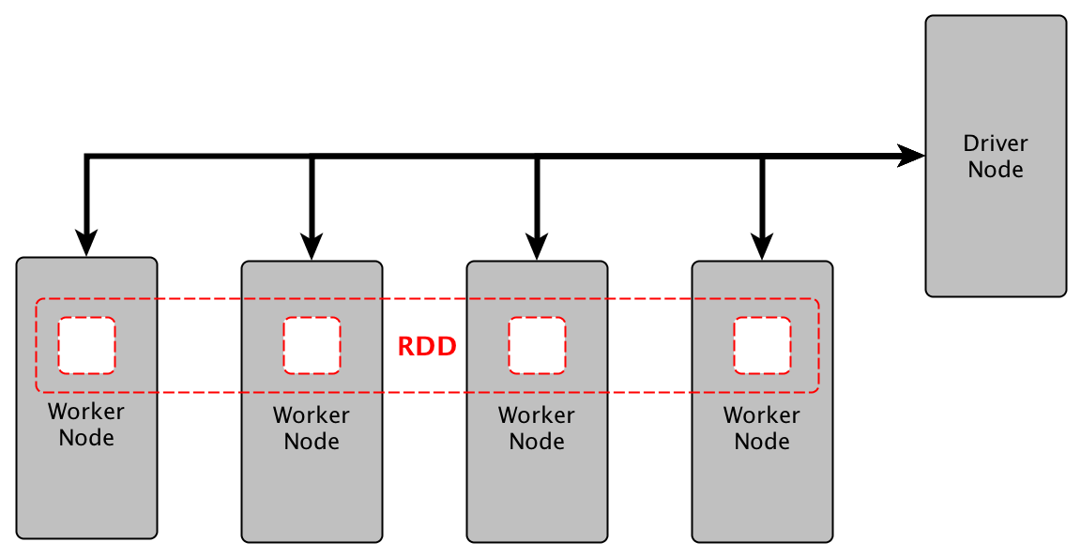
Apache Spark Execution

Slide 6
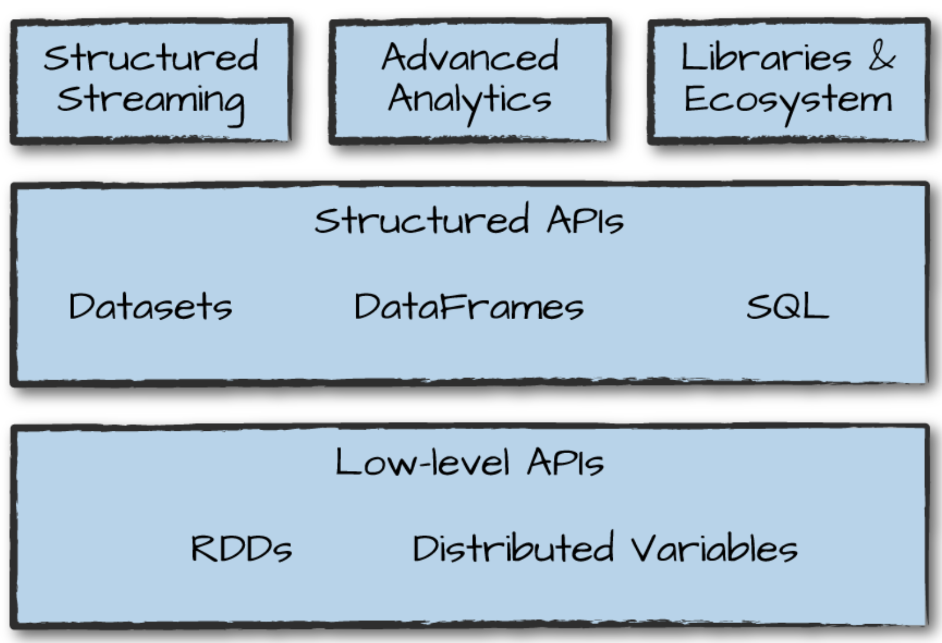
Spark’s Language APIs

Slide 7
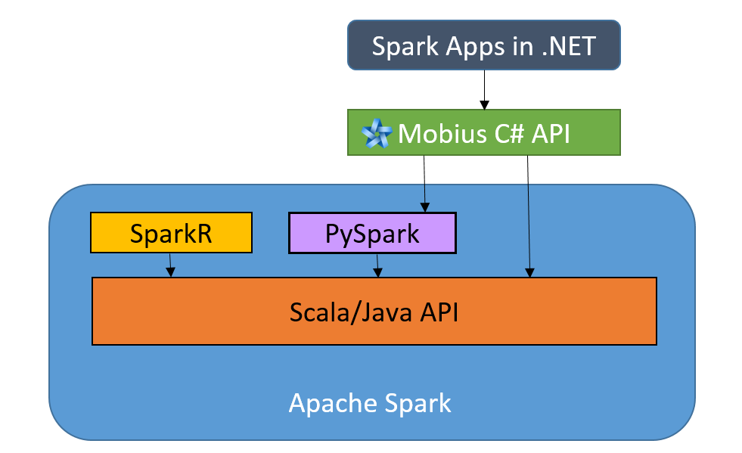
Spark’s Language APIs

Slide 8
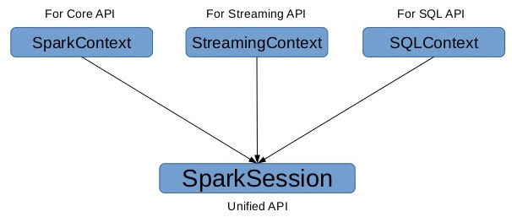
The SparkSession

Slide 9
DataFrames
In Apache Spark, a DataFrame is a distributed collection of rows
It has below characteristics:
Immutable in nature
We can create DataFrame RDD once but can’t change it.
Lazy Evaluations
Which means that a task is not executed until an action is performed.
Distributed

Slide 10
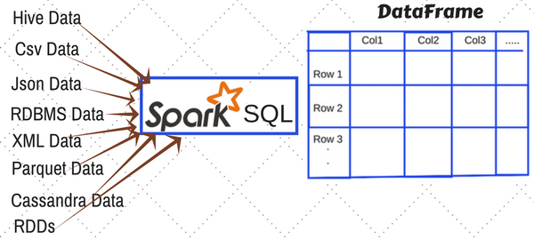
Ways to create DataFrame in Spark

Slide 11
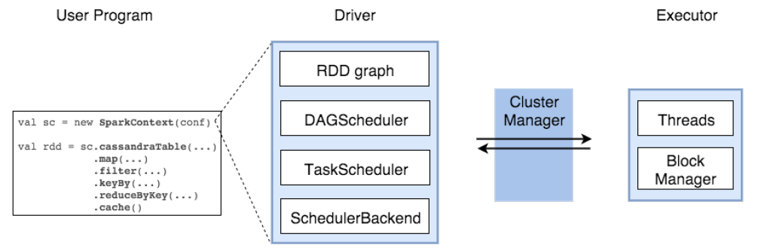

Slide 12
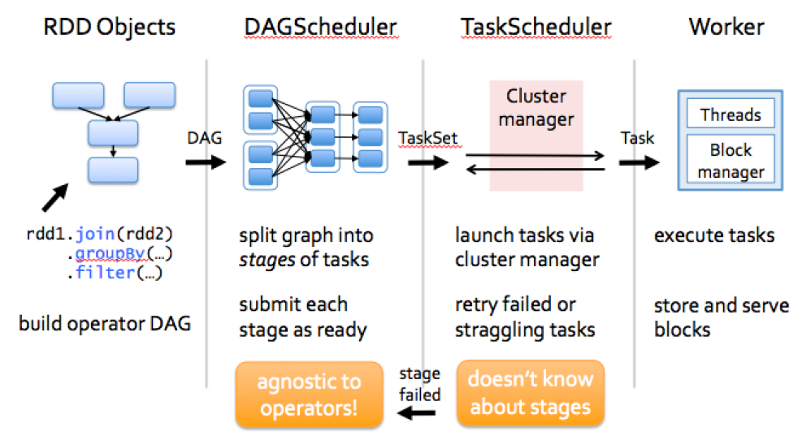
How Sparks work?

Slide 13
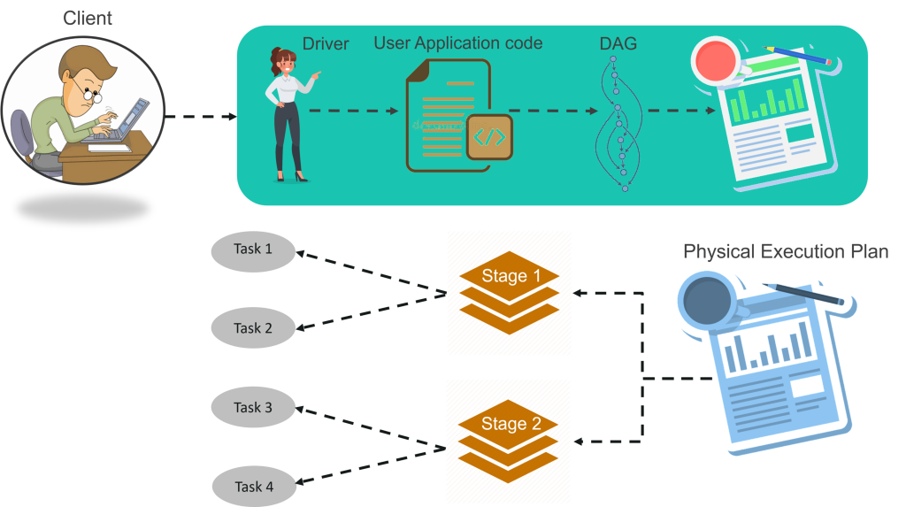

Slide 14
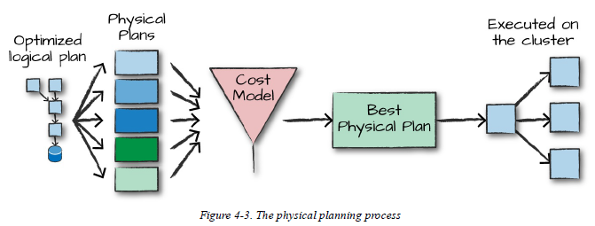
Catalyst Optimizer

Slide 15
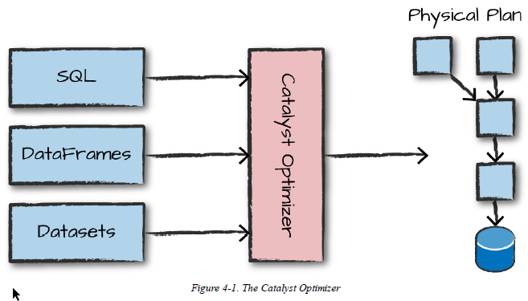
Catalyst Optimizer

Slide 16
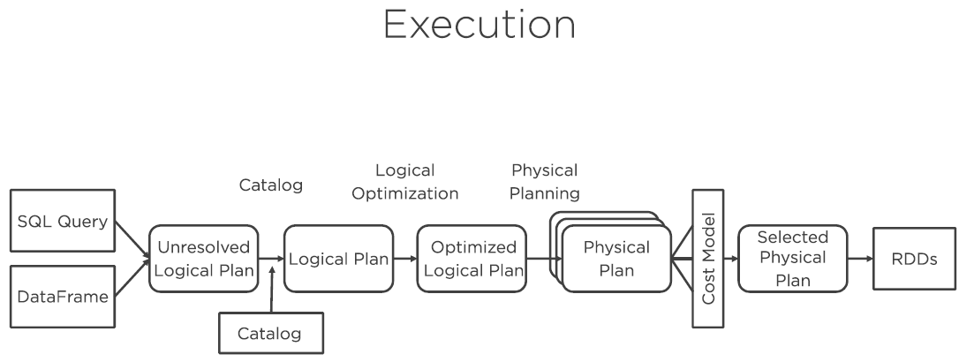

Slide 17
Thanks

